Slide 1
Rotating BEC admixed compact star

Slide 2
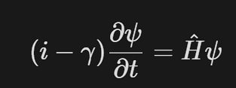
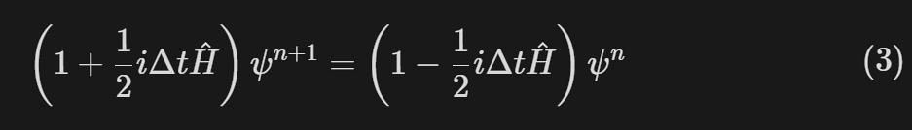
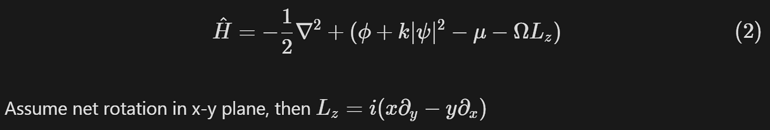
Self-gravitating BEC under rotation
Solve GPE
Hamiltonian

Slide 3
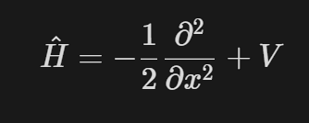
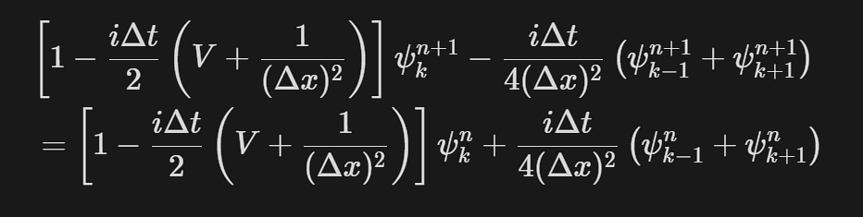
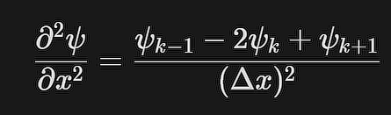
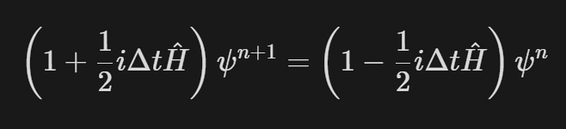
Discretize Hamiltonian
Consider 1D first
Tridiagonal matrix solved by Thomas algorithm

Slide 4

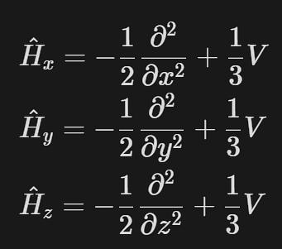
Alternating direction implicate method
In 3D case
Each direction propagates for 1/3dt
Fix y,z when propagate x, …

Slide 5
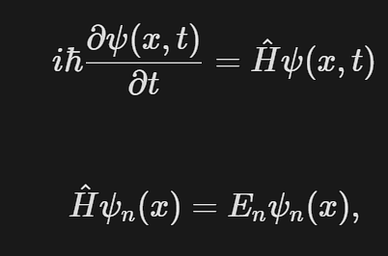

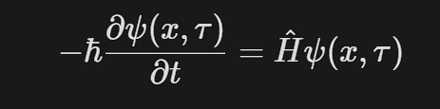
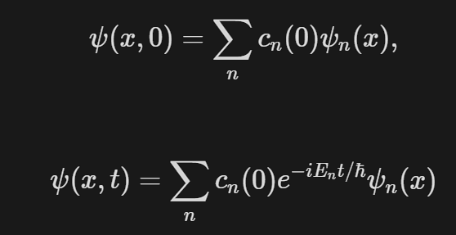
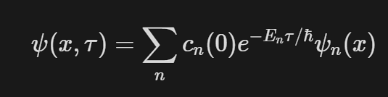
Imaginary time method
Solve GPE with eigen wavefunctions
Any solution can be expressed as eigen functions

Slide 6
Imaginary time method
Wave function is no longer obtained by an "oscillating" superposition of energy eigenstates, but instead by an "exponentially decaying“
After long enough time the ground state points out
This will only work if when you expand the initial state in terms of energy eigenstates, there is some contribution by the ground state. If not, the long imaginary time evolution will instead lead to the lowest energy state present in the initial expansion

Slide 7
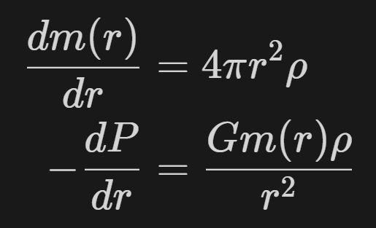
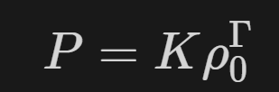
Next step
Search for superfluid in neutron star
Consider gravity dominated by baryonic matter, then simulate the rotating DM governed by NM field, then fix the NM gravity field and find the correction for DM field and iterate
Possibly still use the hydrostatic simulation adding centrifugal force?
Recall that without rotation, we have equations below. We need to add centrifugal force and modify with axial symmetry

